Slide 1
Halfway to Ph.D.? What will happen next?
19.10.2015
Oleksandr Kazymyrov

Slide 2


Pre-graduation
Graduation
Post-graduation
Half a year in industry

Slide 3
Timeline
Middle of PhD
Graduation
Job hunting
Half a year outside Academia

Slide 4
Trend of articles

Slide 5
“Scientific work is not an 8-hour workday. This is thinking 24/7 on the problem, the solution of which no one has yet found. And you are the one who can solve it while been on a train, walking down the street, running in gym, telling an interesting story to friends, or sitting ”
in a garage
_______
Dean of Science, KNURE

Slide 6
Monograph vs Compilation Thesis?
Monograph
Book
Time
Collection of articles
Peer review
Deep

Slide 7



Comparison of thesis submission in Ukraine and Norway

Slide 8



Slide 9
Defense is your 45 minutes of glory!

Slide 10

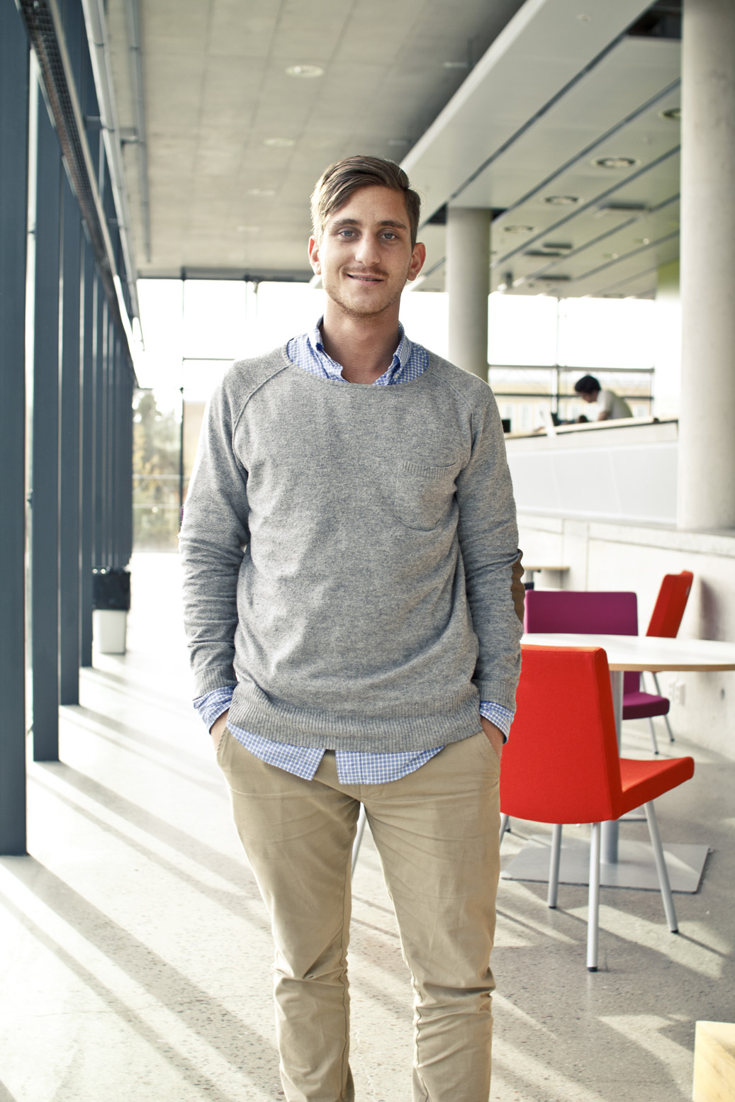


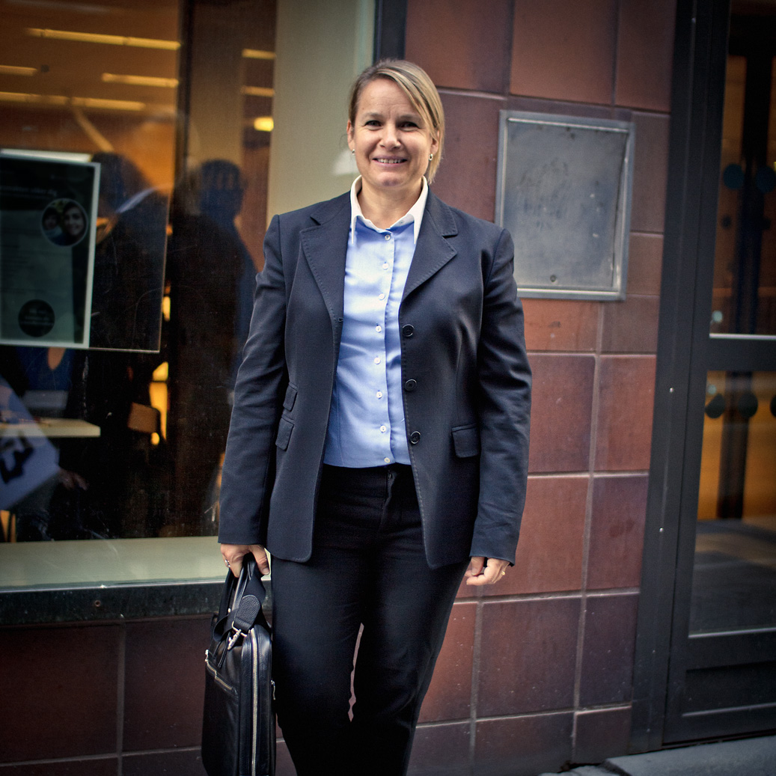
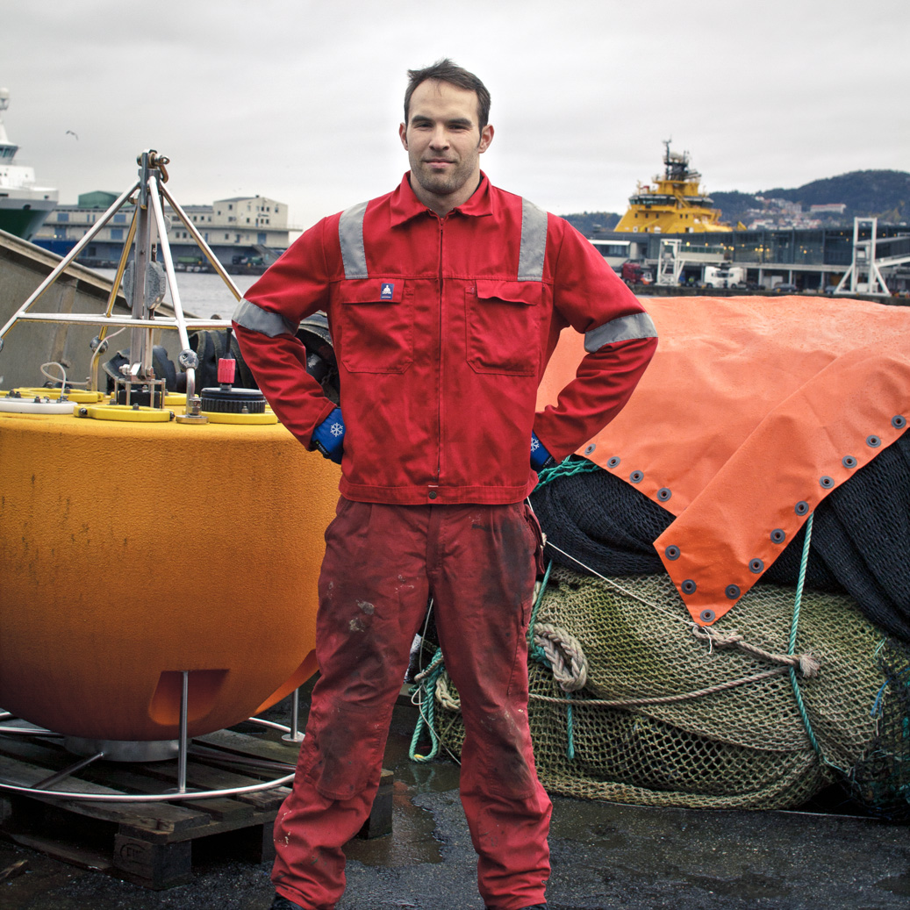


Slide 11
Timeline
Middle of PhD
Graduation
Job hunting
Half a year outside Academia

Slide 12
Possibilities after graduation
Continue research in Academia
Continue research in Industry
Apply your knowledge in Industry
Diploma gives a lot of opportunities
Travel to Tibet

Slide 13
A Life-Cycle of Job Hunting
Interviews (many and various)
Google, CloudFlare, VizRT, Skandiabanken, EVRY
9 month of job search
CloudFlare:
5 rounds
November - March
From a couple of weeks till 3 months of waiting for the final decision
A long-awaited congratulations!
Invitation for interview
1-5
Interviews
Send CV
Job Hunting
Search for a job

Slide 14







Welcome to

Slide 15
Timeline
Middle of PhD
Graduation
Job hunting
Half a year outside Academia

Slide 16
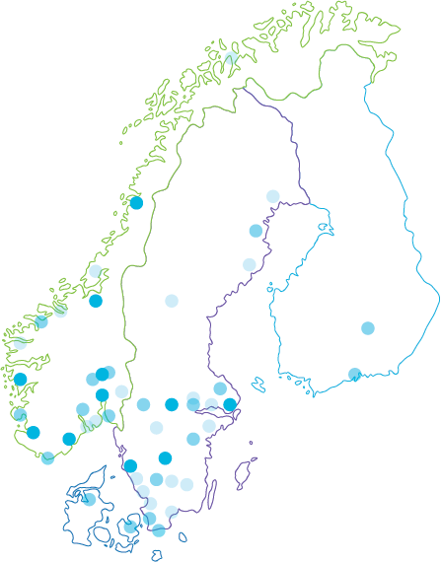
EVRY – the most local IT company in the Nordics
Unique position
Close to our customers
50 towns and cities with capacity to deliver
11 regional offices with specialist competencies
Strong competencies
10,300 employees
4, 900 employees in Norway
2,500 in Sweden
2,900 in India, Ukraine and Latvia
Key figures
Revenue NOK 12.7 bn in 2014
Shareholders
Apax 88%
Listed on the Oslo Stock Exchange since 1997
100+ employees

Slide 17

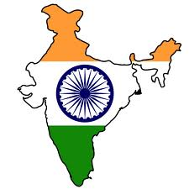
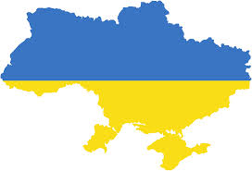
…with strong positions in the Nordic market
Unique position
Norway
# 1 Total market share 31%
# 1 Bank & finance 56%
# 1 SME segment 22%
# 1 Outsourcing 37%
# 1 Consulting 20%
Global sourcing
Latvia: Nearshore Help Desk
Sweden
# 4 Total market share 7.5%
# 1 SME segment 17%
# 5 Outsourcing 6%
# 3 Consulting 7.5%
India: Offshore Operations & AD/AM
Finland: FS and SME-focus
Denmark: FS-focus
Ukraine: Offshore AD/AM

Slide 18

Geographical location

Slide 19
Inside EVRY
Financial services
Project & Business support
Non-functional testing
Pre-production services

Slide 20
What is non-functional testing (NFT)?
P
E
R
F
O
R
M
A
N
C
E
Load
Endurance
Stress
Spike
S
E
C
U
R
I
T
Y
Application layer
Network layer
Wireless
PCI DSS

Slide 21
Security: Application layer
OWASP ASVS 2.0/3.0
OWASP Top 10 (Web applications Web services)
The OWASP Code Review Top 9

Slide 22
Security: Network layer
PCI DSS Requirement 11.2 and 11.3
Perform external penetration testing
Perform internal penetration testing
Verify that the segmentation methods are operational and effective, and isolate all out-of-scope systems from systems in the CDE
Methodologies
PCI DSS Penetration Testing Guidance
NIST Special Publication 800-115
Open Source Security Testing Methodology Manual

Slide 23
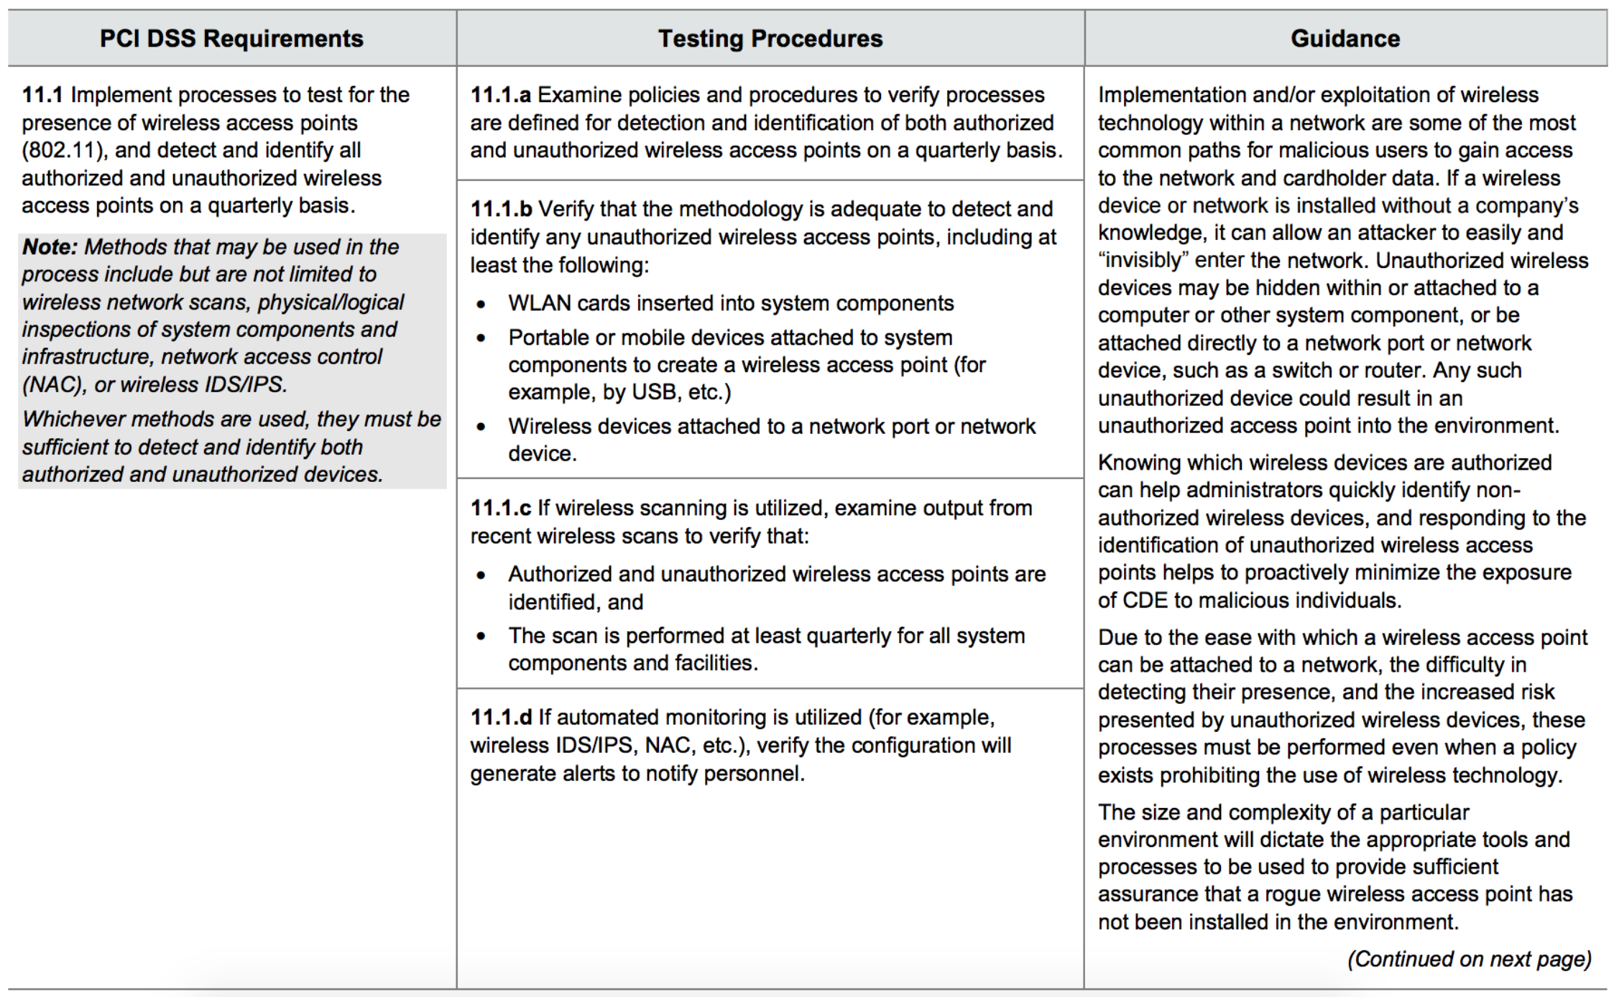
Security: Wireless

Slide 24




On top of that
Enchantment of procedures and methodologies
Self-education and sharing experience
Meetings and co-operations
Installation, configuration and maintenance of auxiliary tools

Slide 25



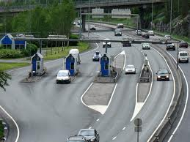
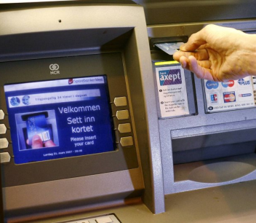

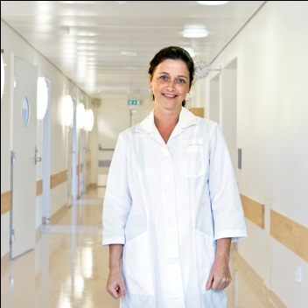

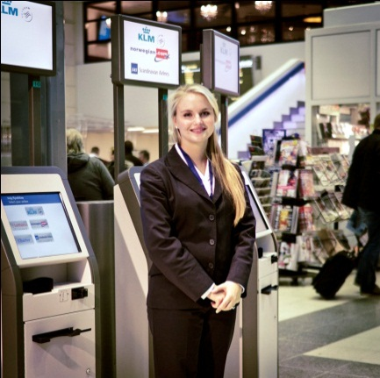
A part of everyday life for millions of Nordic citizens
Unique position
When you
receive a package notification via SMS from the Post
withdraw cash from an ATM in Norway or Sweden
are being credit evaluated
receive the tax assessment from the Norwegian tax authority
pass a toll road station
do a lookup in the national register of motor vehicles
use your credit card or mobile banking services
pick up an e-prescription at an Norwegian pharmacy
buy a ticket with the Swedish railways

Slide 26
“Whatever you do, do it well.”
Pittacus of Mytilene

